Slide 1
Skin Lesion Detection using VGG-16 and ResNet50 based Hybrid CNN Model

Slide 2
INTRODUCTION
1. Skin Cancer Prevalence:
- global health concern, affecting a significant portion of the population.
- Malignant melanoma, the deadliest form, claims around 10,000 lives annually.
2. Computational Approach for Diagnosis:
- proposed an automated computational approach for skin lesion categorization.
- Utilizes deep features extracted from various abstraction levels and CNN architectures.
- Aims to improve accuracy and efficiency in diagnosing skin lesions.
3. Importance of Early Melanoma Detection:
- rise in Melanoma's prevalence over the past three decades.
- Early detection is key to achieving a high survival rate
- Dermoscopy imaging aids in identifying pigmented skin lesions, including suspected melanomas, using a non-invasive method.

Slide 3
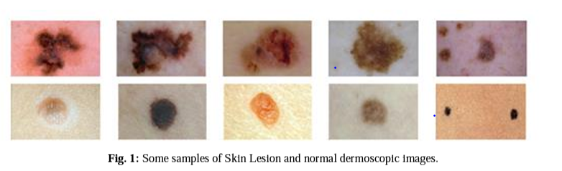

Slide 4
Motivation
1. Urgent Threat of Cancer:
- Cancer poses a severe and often fatal threat to human life.
- Skin cancer, a rapidly growing malignancy, is particularly concerning due to its potential lethality.
2. Complex Causes and Risk Factors:
- Skin cancer arises from a multitude of factors including UV exposure, lifestyle choices, infections, and environmental changes.
- UV rays from the sun are particularly damaging, causing DNA damage within skin cells.
3. Significance of Early Detection:
- Skin cancer carries a substantial risk of death, with an estimated 50% mortality rate.
- Early detection through simple excision can significantly improve survival chances.
- There's a critical need for an efficient, non-invasive system for detecting skin lesions to reduce mortality rates associated with skin cancer.

Slide 5
Literature Review
1. Varied Approaches in Skin Lesion Detection:
- researchers have proposed skin lesion detection systems, often leveraging CNN techniques such as AlexNet, ResNet, and GoogLeNet.
- Existing systems are mostly PC-based, requiring specific setups and peripherals for data collection.
2. Prior Studies and Challenges:
- Ganster et al. [4] developed an integrated system using algorithm fusion for picture segmentation and melanoma detection.
- Ercal et al. [5] combined commercial Neural Network classifiers with dermatologist-determined lesion boundaries to achieve successful classification.
- Existing methods lack mobile device compatibility and consideration for the general public.
3. Limitations and Focus on Pre-Trained Networks:
- Previous studies often relied on specific pre-trained network topologies or individual layers for deep feature extraction.
- Limited use of pre-trained networks, such as AlexNet, VGG16, and Inception-v3.

Slide 6
Proposed Approach:
- This study uses an improved version of the VGG-16 CNN and ResNet-50 architecture.
- Classifies skin lesion images captured via camera into Nevus, Seborrheic Keratosis, and Malignant categories.
- VGG-16 and ResNet-50 chosen due to demonstrated efficacy in various applications, including medical image processing.

Slide 7
VGG-16 CNN MODEL
- VGG16 achieved victory in the 2014 ILSVR (ImageNet) competition, establishing itself as a groundbreaking CNN architecture.
- VGG16 emphasized using 3x3 convolution layers with stride 1, maintaining consistent padding and 2x2 maxpool layers with stride 2.
- The architecture maintains a consistent pattern of arranging convolution and max pool layers.
- It culminates with two fully connected layers (FC) and a softmax layer for output.
- The "16" in VGG16 indicates the presence of 16 layers with weights.
- VGG16 boasts approximately 138 million parameters, contributing to its substantial size.
- Figures demonstrated provide a visual representation of the internal details and flow diagram of the VGG-16 CNN model.

Slide 8
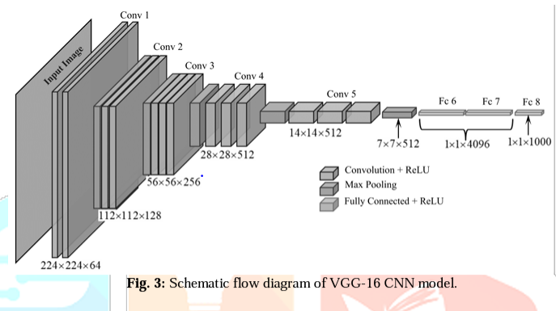

Slide 9
RESNET-50 CNN MODEL
- ResNet's innovation lies in enabling the training of extremely deep neural networks, surpassing 150 layers.
- Prior to ResNet, training very deep neural networks was challenging due to the vanishing gradient problem.
- The ResNet-50 model is divided into 5 stages, each containing a convolutional layer and an identity block.
- Both identity blocks and convolutional blocks consist of three convolution layers each.
- ResNet-50 comprises over 23 million trainable parameters, contributing to its complexity and performance.

Slide 10
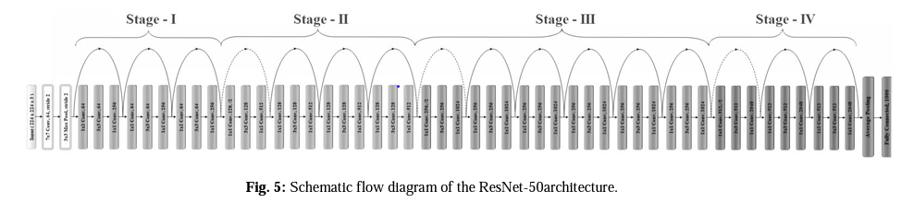

Slide 11
Proposed Model
- ISIC Archive and similar initiatives provide accessible data for CNN-powered diagnosis.
- Two research trends exist in skin lesion detection: CNN architectures using transfer learning, and unsupervised learning followed by supervised classification.
- presented work adopts transfer learning due to limited availability of larger datasets.
- The proposed hybrid CNN model fuses pre-trained VGG-16 and ResNet-50 features for skin lesion detection.
- VGG-16's final max pooling layer and ResNet-50's final average pooling layer are used as inputs to separate Fully Connected (FC) layers.
- A new 1x2048 FC layer fuses features from VGG-16 and ResNet-50's 1x1024 FC layers.
- An additional 1x512 FC layer extracts more salient features, followed by a final 1x3 FC layer with Softmax activation for classification.
- The hybrid CNN model is retrained using 80% of the dataset, with 20% reserved for validation.

Slide 12
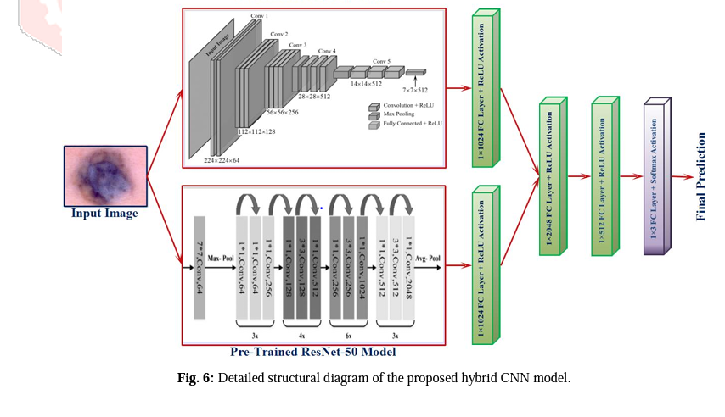

Slide 13
Results
- The hybrid model was trained 5 times each for 200 epochs with specific settings for authenticity.
- Transfer learning concept was employed, with a common classification layer for both VGG-16 and ResNet-50.
- Hybrid model performances were evaluated based on their accuracy:
- VGG-16 backbone achieved an accuracy of 0.8040.
- ResNet-50 backbone achieved an accuracy of 0.8343.
- The hybrid model with both VGG-16 and ResNet-50 achieved an accuracy of 0.8565.
- Comparative analysis revealed that the proposed hybrid model yielded the highest average test accuracies.
- Despite previous works favoring VGG-16 or ResNet, the hybrid model performed best for this dataset.
- The results highlight the suitability of the hybrid model for skin lesion classification.

Slide 14
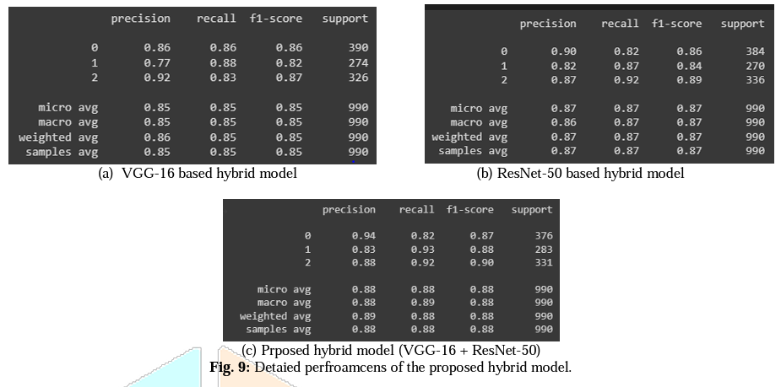

Slide 15
Conclusion
1. Innovative Hybrid Model Triumphs:
2. Model Suitability and Variability:
3 Progress Towards Accurate Diagnostics:

